Slide 1
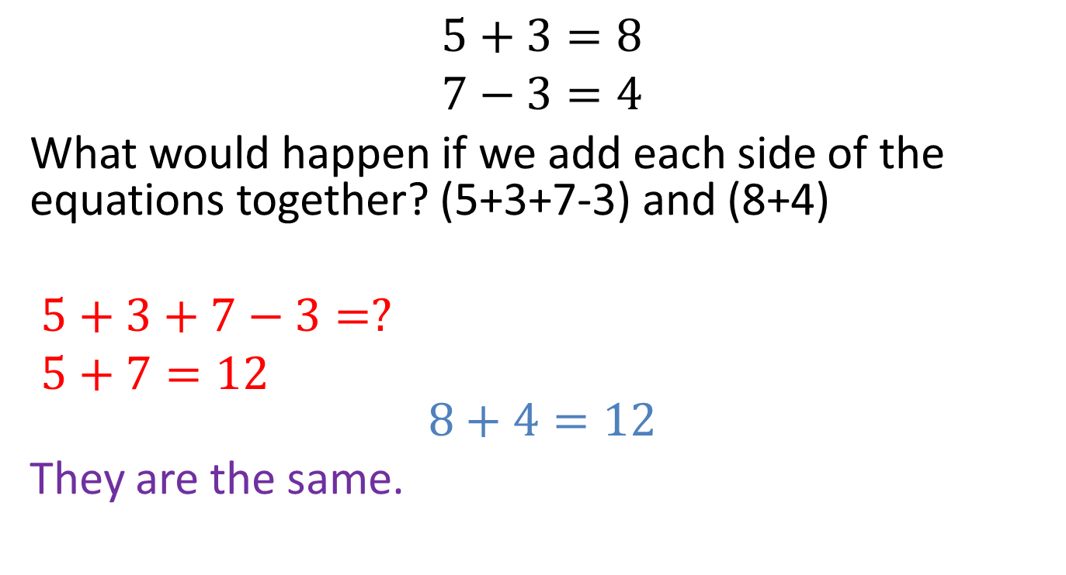
Do you agree?
$$5+3=8 \\ 7−3=4$$
What would happen if we add each side of the equations together? (5+3+7-3) and (8+4)
$5+3+7−3=?$
$5+7=12$ $$8+4=12$$
They are the same.
The 3s get eliminated
(3-3=0)
Notes:
hook

Slide 2
24
7
30
Date
Simultaneous equations
EQ –How can we solve simultaneous equations with the elimination method
5
Notes:
Lesson objective (EQ)

Slide 3
Lesson objective
By the end of this lesson you will be able to;
- Solve Simultaneous equations using the elimination method.
Notes:
Lesson

Slide 4

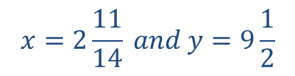


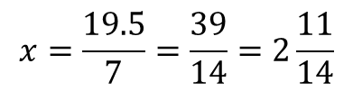
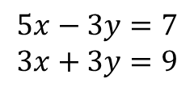
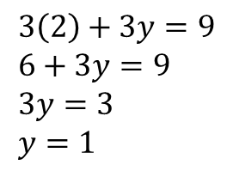




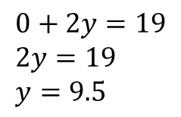
24
7
30
Date
Simultaneous equations
EQ –How can we solve simultaneous equations with the elimination method
The elimination method is where we eliminate one of the variables in order to solve.
$$7x−y=10 \\ −7x+3y=9$$
Add each side together to eliminate.
Solve for the variable
Solve for other variable
$$5x−3y=7 \\ 3x+3y=9$$
$$0+2y=19 \\ 2y=19 \\ y=9.5$$
$$8x+0=16$$
$$8x=16$$
$$x=2$$
$$7x−\left(9.5\right)=10$$
$$7x=19.5$$
$$3\left(2\right)+3y=9 \\ 6+3y=9 \\ 3y=3 \\ y=1$$
$$x=\frac{19.5}{7}=\frac{39}{14}=2\frac{11}{14}$$
$$x=2 and y=1$$
$$x=2\frac{11}{14} and y=9\frac{1}{2}$$
5

Slide 5
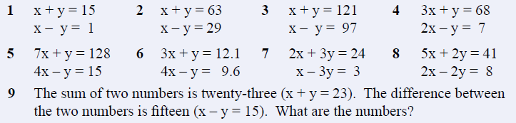
Use the elimination method to solve these please!
Notes:
Check for understanding/ independent practice

Slide 6
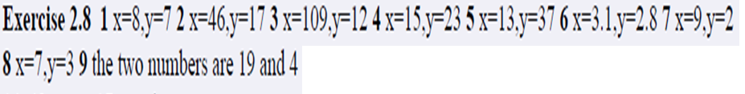
Answers

Slide 7
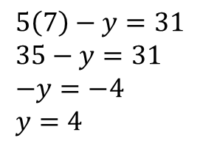
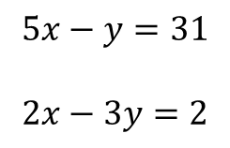
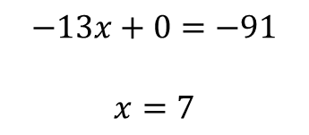




24
7
30
Date
Simultaneous equations
EQ –How can we solve simultaneous equations with the elimination method
1
$$5x−y=31$$
$$2x−3y=2$$
2
1
$$×−3$$
$$−15x+3y=−93$$
$$5\left(7\right)−y=31 \\ 35−y=31 \\ −y=−4 \\ y=4$$
$$2x−3y=2$$
$$−13x+0=−91$$
$$x=7$$
$$x=7 and y=4$$
5
Notes:
Input

Slide 8
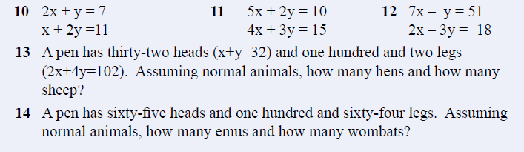
Answer these please
Notes:
Guided practice

Slide 9
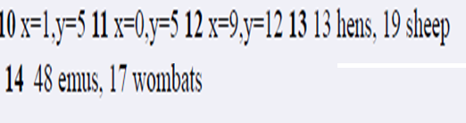
Answers

Slide 10
Summary
Write the steps to solving simultaneous equations with the elimination method.
Which is your favourite method (graphically, substitution or elimination)? Why?
Notes:
Closure

